Slide 1

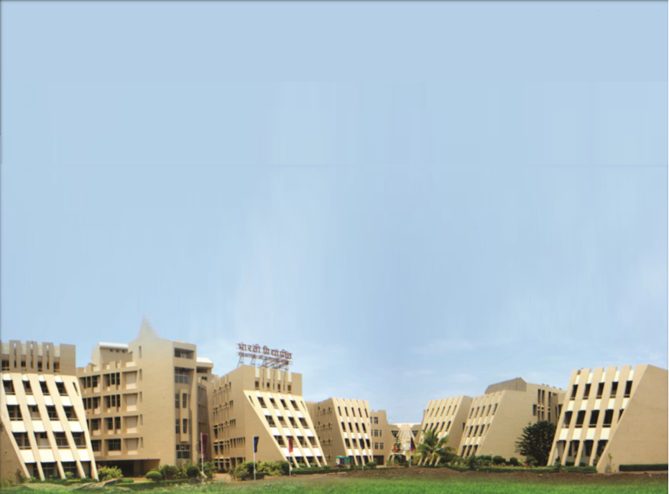
Social Transformation Through Dynamic Education
FINAL YEAR ENGINEERING AND TECHNOLOGY
Semester –VI
Mega Project

Slide 2
BHARATI VIDYAPEETH’S
COLLEGE OF ENGINEERING, KOLHAPUR.
FINAL YEAR OF ENGINEERING AND TECHNOLOGY
Department of Electronics & Telecommunication Engineering
A
Project Presentation
ON
AN AUTOMATION USING ALEXA AND RASPBERRY-PI
Under guidance of
Dr. M.S.Sonawane
Presented by
Chavan Harshal Sameer
Gaikwad Kunal Rajendra
Patil Sushant Arjun

Slide 3
Content
1
Introduction
2
Block Diagram
3
Circuit Diagram
4
Component Details
5
Advantages and Dis-advantages
6
Application

Slide 4
Introduction
Virtual assistants are a software that understands verbal commands and completes task assigned by clients.
In existing system of virtual assistance there several virtual assistance in market by using artificial intelligence technology. Such as Microsoft Cortana for windows, Siri for iOS, etc.
In this project we are suing python programming language because offers a good major library.
Virtual assistants can provide several services which includes,
Showing weather condition.
Gives latest news.
Turn on/off light.
Showing datetime, Telling jokes.
Searching on Wikipedia ,etc.

Slide 5
Block Diagram
Power Supply
Light
Speaker
Fan
Raspberry Pi
LCD Screen
Mic
TV
Node MCU
Relay
Fig1.Block Diagram of Automation Using Alexa and Raspberry Pi

Slide 6
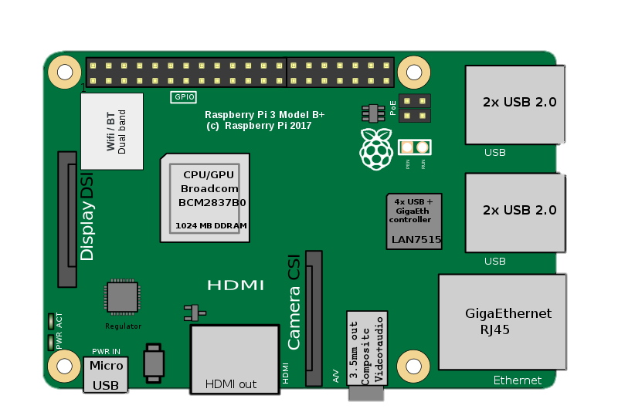

Relay
Circuit Diagram
Node MCU
Data
Internet
MicroSD
Card
Sound Cable
Mic
Power
Voice
(Input)
Speaker (Output)

Slide 7
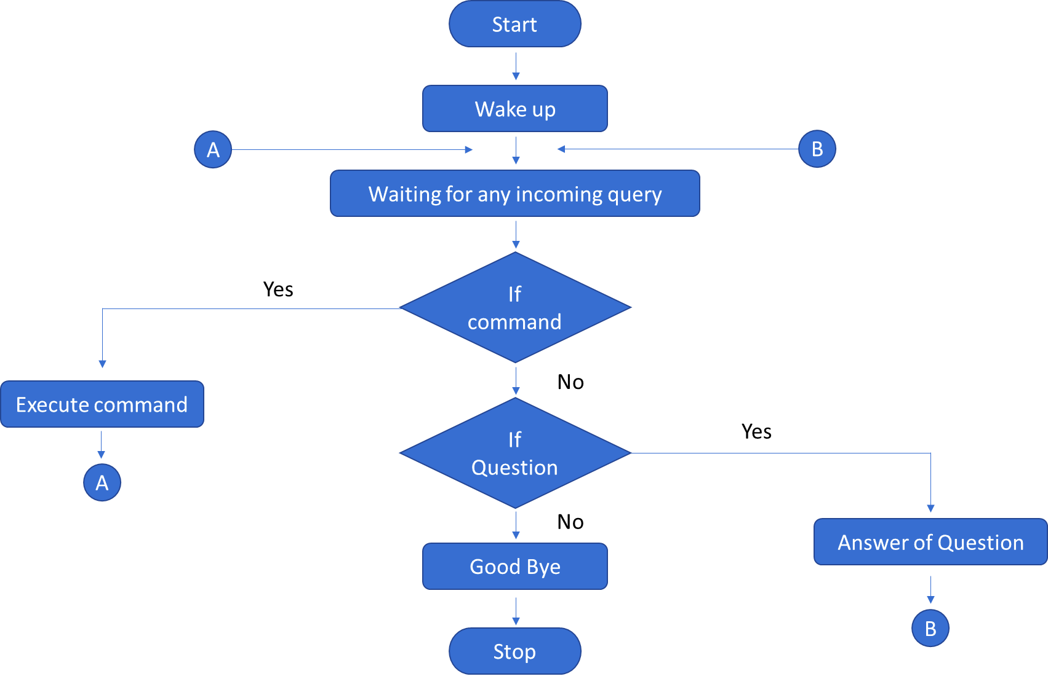
Flow Chart

Slide 8
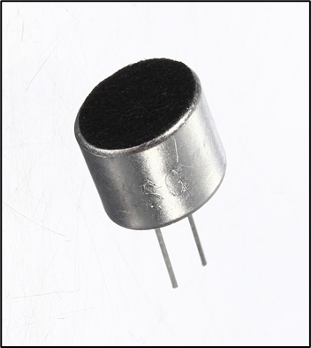




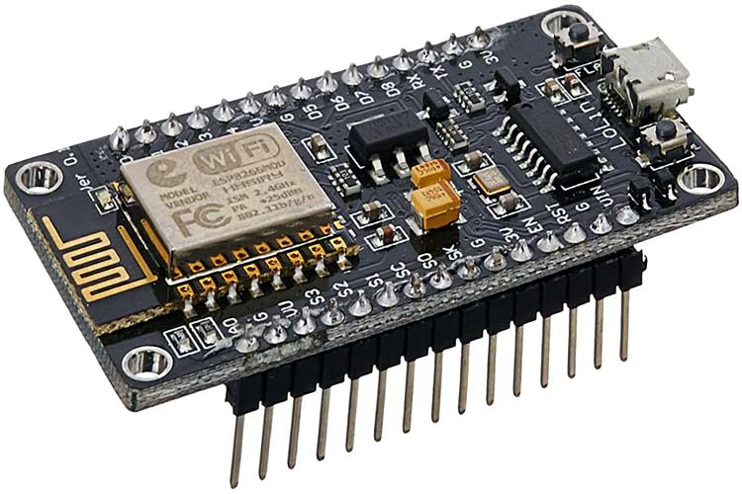
Component Details
Hardware
Software
Microphone
Python IDE
Raspberry-Pi 3 B+ Model
4 - Channel Relay Module
Speaker
Node MCU

Slide 9
Microphone
A microphone converts sound into a small electrical current. Sound waves hit a diaphragm that vibrates, moving a magnet near a coil.
The dynamic microphone (also known as the moving-coil microphone) works via electromagnetic induction.
They are robust, relatively inexpensive and resistant to moisture. This, coupled with their potentially high gain before feedback, makes them ideal for on-stage use.
Dynamic microphones use the same dynamic principle as in a loudspeaker, only reversed.

Slide 10
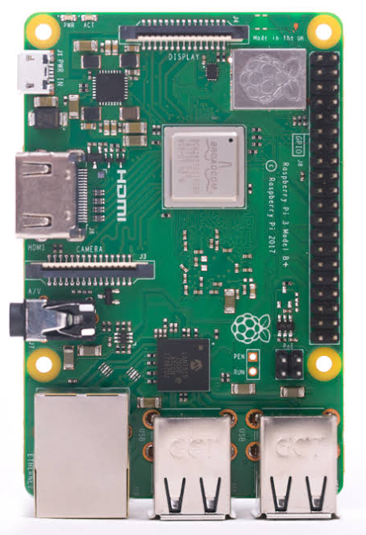
Raspberry-Pi 3 B+
Input power:
5V/2.5A DC via micro USB connector
5V DC via GPIO header
Connectivity:
2.4GHz and 5GHz IEEE 802.11.b/g/n/ac wireless
LAN, Bluetooth 4.2, BLE
Gigabit Ethernet over USB 2.0 (maximum throughput 300Mbps)
4 × USB 2.0 ports
Processor:
Broadcom BCM2837B0, Cortex-A53
64-bit SoC @ 1.4GHz

Slide 11
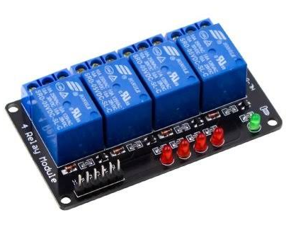
Relay Module
The relay is the device that open or closes the contacts to cause the operation of the other electric control.
Protects the system from damage. It works on the principle of an electromagnetic attraction.
Specification:
Supply Voltage- 3.75v-6v.
Trigger current-5mA
Current when the relay is active-~70mA(single),~300mA (all four)
Relay maximum current-10A

Slide 12

Speaker
Speaker is defined as an electrical device used to make sound.
The primary objective of speakers is to offer audio output for the listener.
The electromagnetic waves are converted into sound waves through the speaker as they are transducers.
The devices, like an audio receiver or computer, give audio input to speakers, which may be in the form of analog or digital.
Speakers work by converting electrical energy into mechanical energy (motion).
In project use electrodynamic loudspeaker

Slide 13
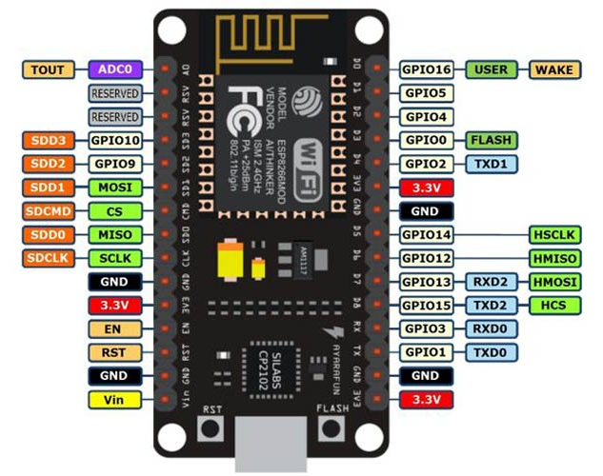
NodeMCU
NodeMCU is a low-cost open source IoT platform. It initially included firmware which runs on the ESP8266 Wi-Fi
The program connects to the Wi-Fi network using the provided password and SSID.
It then proceeds to connect to the provided cloud/host server using the client.connect() function, and sends the provided URI to the host server using the client.print() function.
It does this with the client.available() function, which checks whether there is incoming data from the server. If there is data available, the sketch reads it and displays it on the serial monitor.

Slide 14

Python IDE
Why used python ?
One of the most widely used programming languages on the raspberry pi is none other than python.
Python has an easy, beginner-friendly syntax (arrangement of words, phrases, in sentences)and a wide adoption rate among the community, giving access to libraries, frameworks, and tools to help users get started!
Useful in applications in different industries such as web development, GUI, automation & Machine Learning, learning python programming language is the safe stand easy way to get started!

Slide 15
Advantages
The ease to switch on and off any device without putting in some extra effort has been the main motto of this device.
Energy saving.
Accessibility.
Convenience and time saving.
Control.
Comfort.
Easy communication.
Peace of mind.
Smart homes may be suitable for disabled persons.

Slide 16
Dis-advantages
Dependency on Internet
Internet security
Greater acceptance
Dependency on Professional

Slide 17
Applications
Smart kitchen &connected to cooking.
01
Lighting control system.
02
03
Appliance control and integration.
Occupancy aware control system.
04

Slide 18
Reference
[1] “A combined approach for home automation using raspberry pi” Indian journal of science and technology by R.Josphineleela, S.S.Sivanya, S.Varshitha,
S.Vizhiaras.
[2] ”Iot based home automation system using raspberry pi3” international researchjournal of engineering and technology( IRJET) volume:4 issue:05, may2017.
[3] “Advanced home automation system using raspberry pi and Arduino”international journal of computer science and engineering(ijcse) vol:8, issue 2, feb - mar 2019.
[4] Http://www.Raspberrypi.Org/documentation/installation/noobs.
[5] Raspberry pi cookbook by Simon monk.

